Slide 1
LIFE IN UNITED STATES
-Prema Krishna Gadde
-Anastasiia Bugai
-Tomiloba Ogundipe

Slide 2
INTRODUCTION
Immigrant students in the class.
The main identifier is every state in United States of America.
We have used various sources to create the entire dataset.
Data is for the year 2017.
Main themes are crime, education, and income inequality.

Slide 3
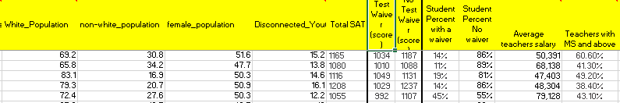
DATA SET

Slide 4

EDUCATION

Slide 5

Does High School education affect the state population?

Slide 6
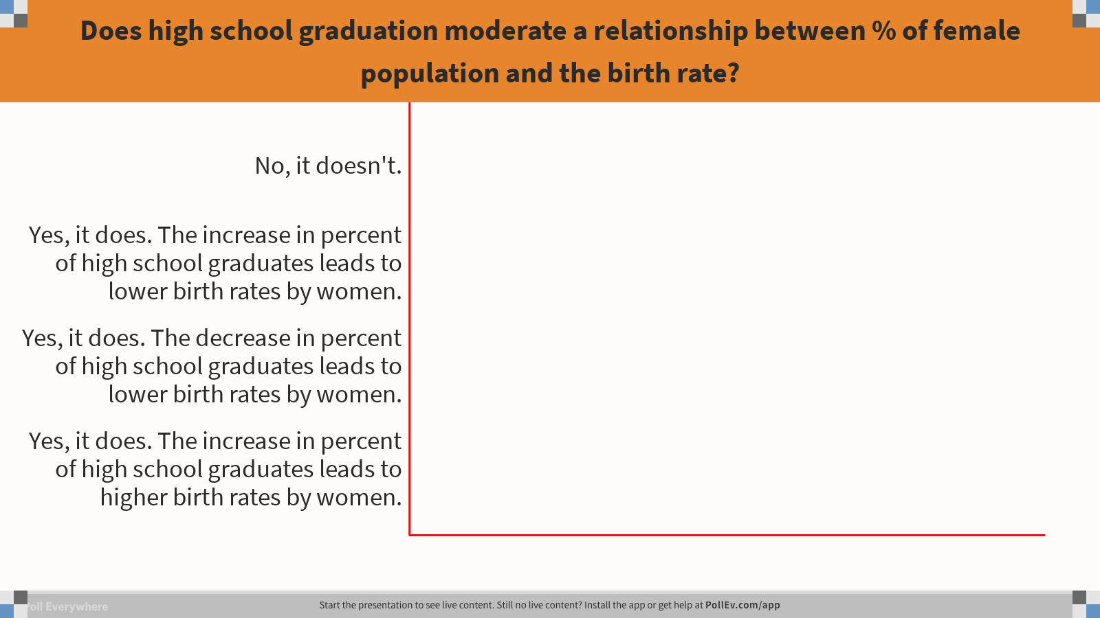
Notes:
Poll Title: Does high school graduation moderate a relationship between % of female population and the birth rate? https://www.polleverywhere.com/multiple_choice_polls/z3zVGMs2KqDXwfM

Slide 7
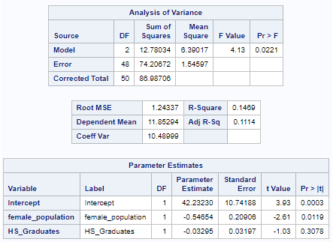
Birth rate is the dependent variable.
The model is good.
The female population has a negative impact on the birth rate.
HS graduates does not impact the birthrate.

Slide 8
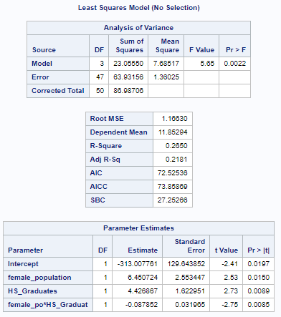
The model is good
High school graduates moderate the relationship between the female population and birthrate.
Despite the relation being negative, the high school graduates have decreased the negative impact between the female population and the birthrate.

Slide 9

Does students’ success and teachers’ level of education predict a teachers’ salary?

Slide 10
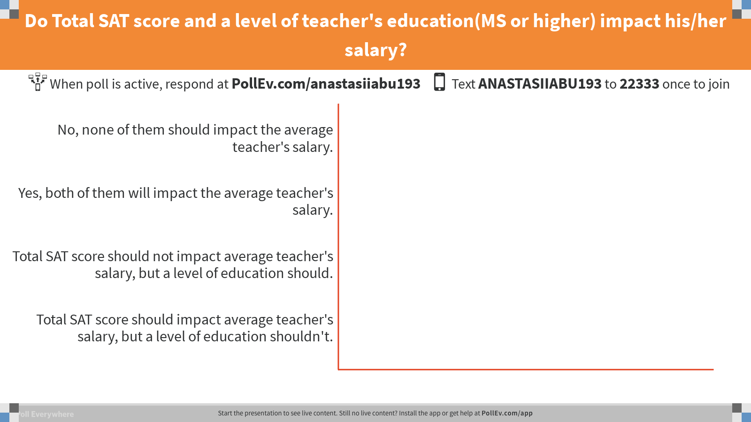
Notes:
Poll Title: Do Total SAT score and a level of teacher's education(MS or higher) impact his/her salary? https://www.polleverywhere.com/multiple_choice_polls/mlL3oa99UwJXlE4

Slide 11
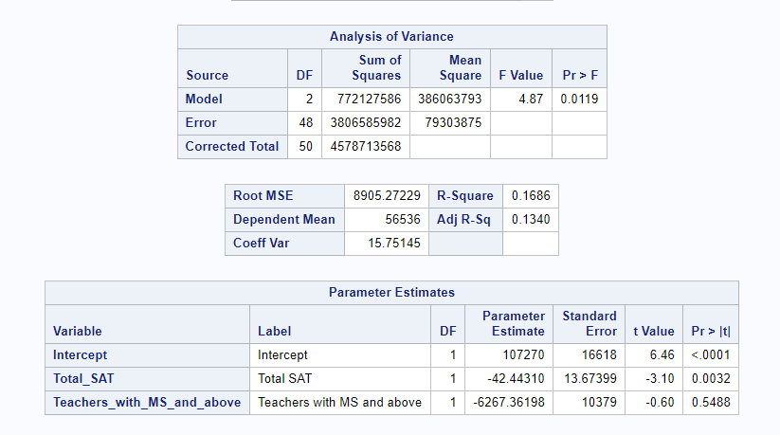
Dependent variable: Average teachers' salary
Independent variables: Total SAT score, Percent of teachers with MS and above
As Students' SAT Score is increasing, the teacher's salary is decreasing.
Teachers' Masters or higher degree of education does not have an impact on the salary.

Slide 12

Would a fee waiver impact the result of the SAT score?

Slide 13
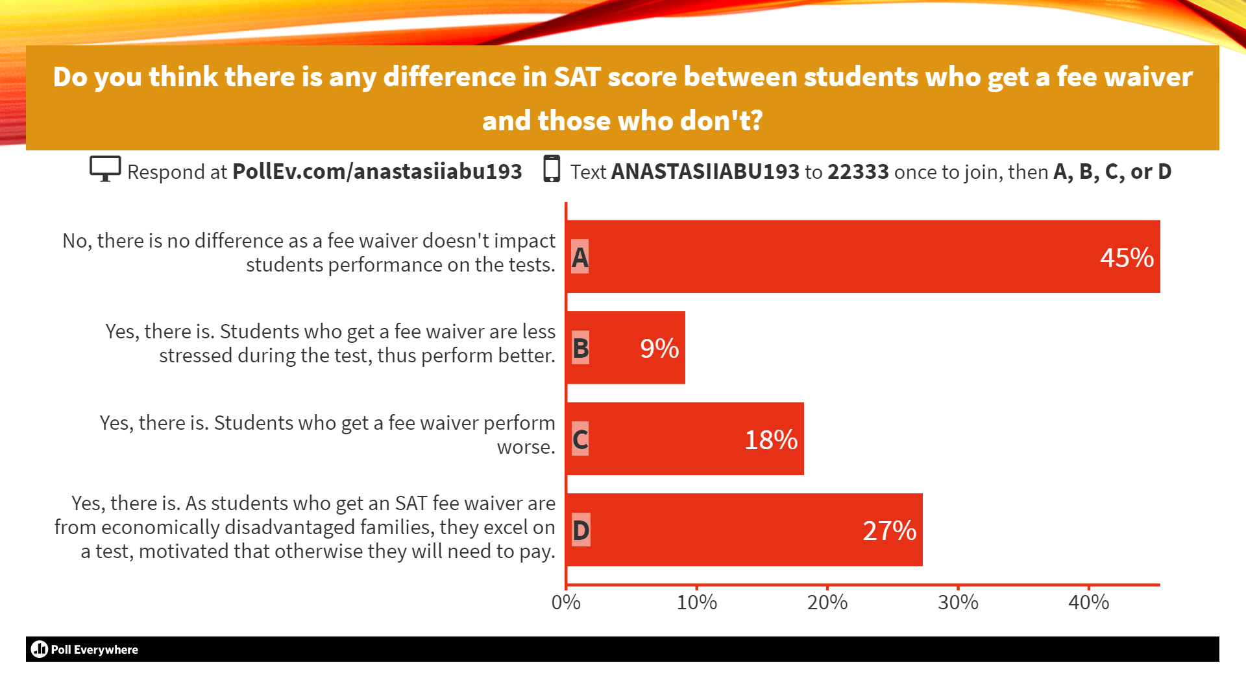
Notes:
Poll Title: Do you think there is any difference in SAT score between students who get a fee waiver and those who don't? https://www.polleverywhere.com/multiple_choice_polls/iXlKzThYGHYuZX6

Slide 14

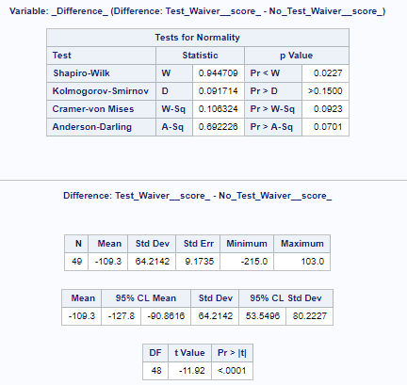
The P value is less than 0.05, thus, we reject the null.
There is a difference in the test score between the two groups.
The students with a fee waiver have less scores when compared to the students without test wavier.

Slide 15

CRIME

Slide 16

Does a stronger police force deter crime?

Slide 17
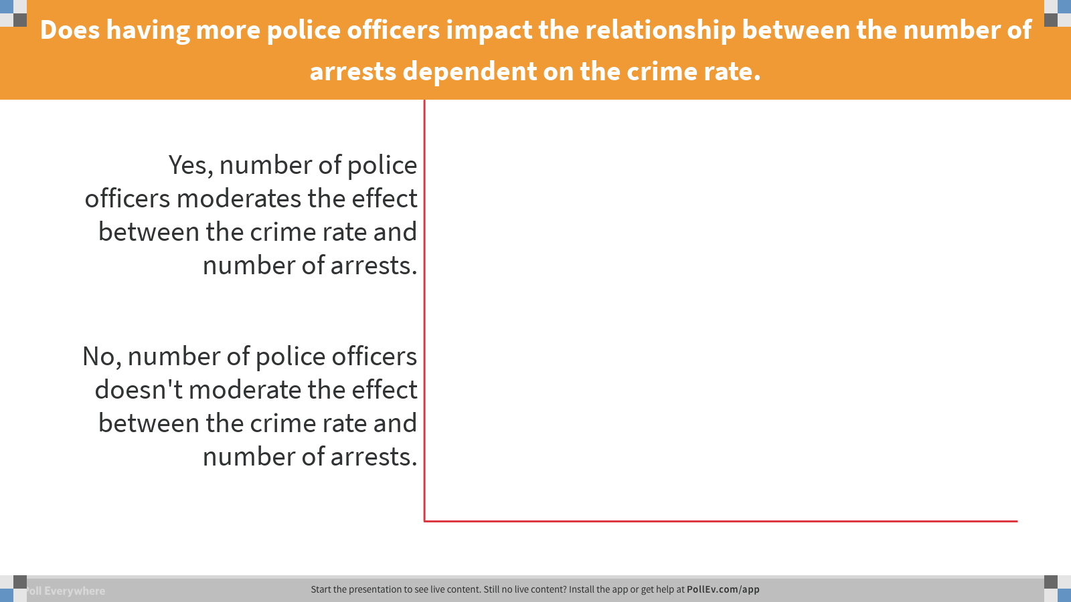
Notes:
Poll Title: Does having more police officers impact the relationship between the number of arrests dependent on the crime rate. https://www.polleverywhere.com/multiple_choice_polls/EZ8ZaFcAdtIxjNv

Slide 18
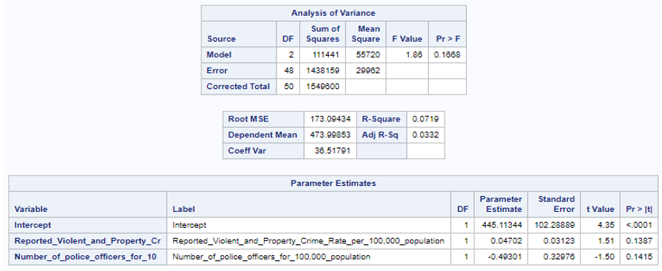
Dependent variable: Number of reported arrest for violent crimes and property crimes.
The model is not statistically significant .
Reported violent crimes and property crimes as well as Number of police people does not have an impact on the number of arrests.

Slide 19
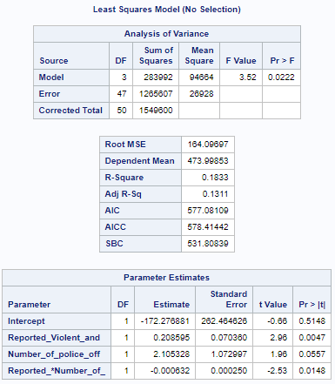
Moderation analysis
The model is statistically significant.
Number of policemen moderates the relationship between the reported crime rate and the number of arrests.
The number of police officers moderates the effect between the crime rate and number of arrests.

Slide 20
Do crimes happen more often in inequal societies?

Slide 21
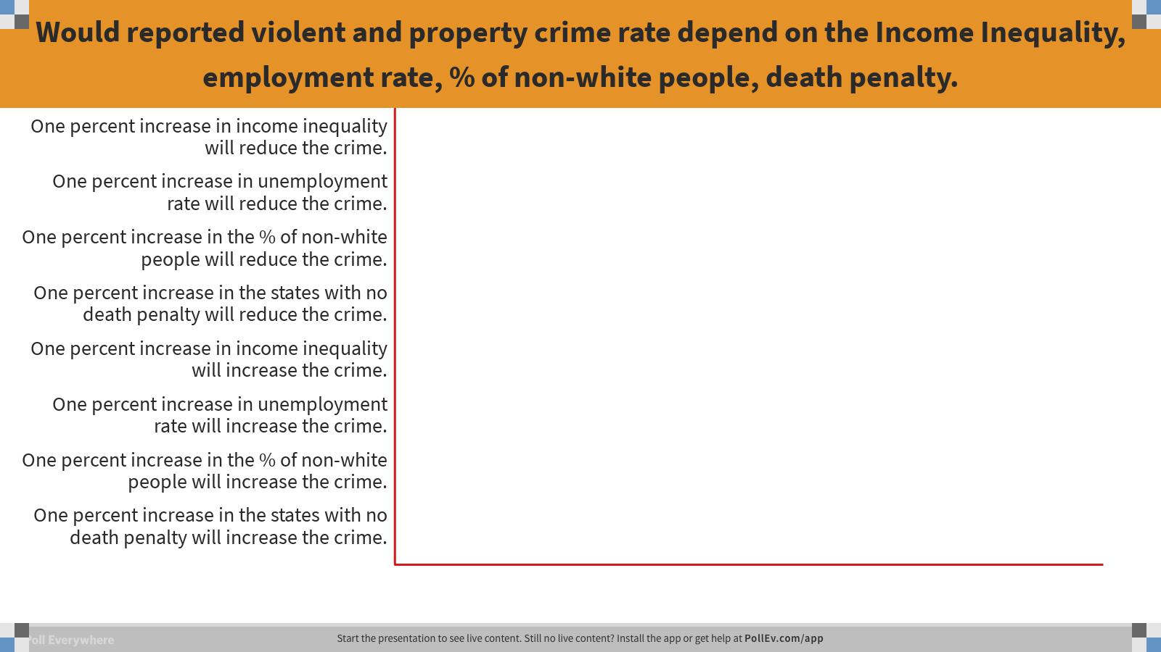
Notes:
Poll Title: Would reported violent and property crime rate depend on the Income Inequality, employment rate, % of non-white people, death penalty. https://www.polleverywhere.com/multiple_choice_polls/AJUILmEgS21ZB30

Slide 22
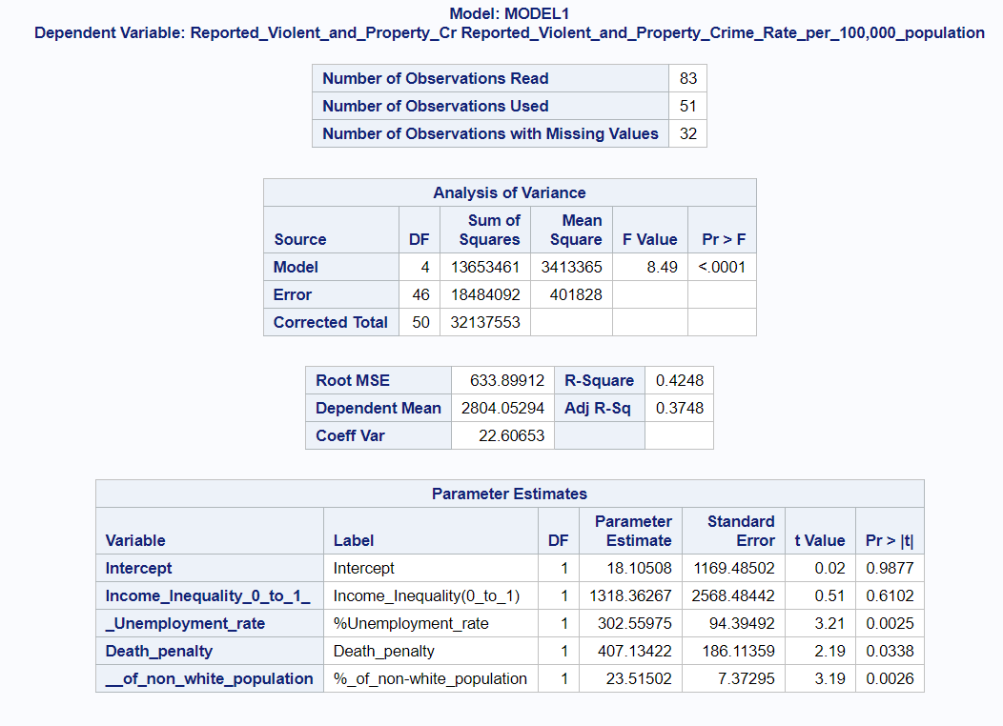
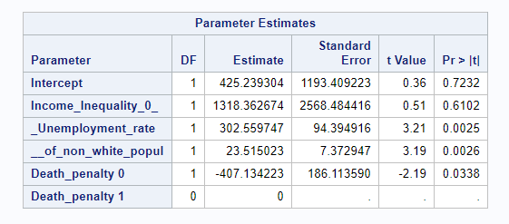
Multiple regression
Dependent variable: Reported Violent and property crime rate.
The model is statistically significant.
The income inequality does not have an impact on the reported crimes.
As the unemployment rate and the non-white population is increasing the income inequality is also increasing.
The reported crime is less in the states where there is no death penalty, compared to the states with death penalty.

Slide 23
Does income inequality depend on the political party strength?

Slide 24
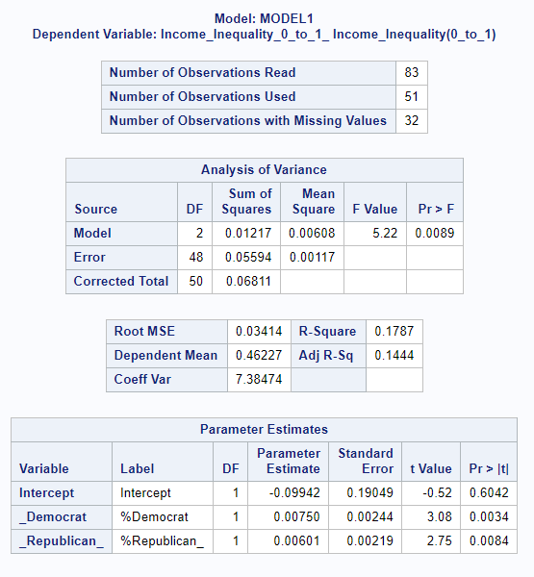
Dependent variable: Income inequality.
Independent variables: Percent Democrats, Percent Republicans
Income inequality increases in democratic and republican states .
We can see that the when the republic party percentage influences the income inequality in a less way as compared to the democrat party.

Slide 25
SOME MORE FINDINGS
As the average temperature is increasing the binge drinking is reducing.
Life expectancy in warmer states is less as compared to colder states.

Slide 26
BAD BUT INTERESTING FINDING
High school drop out rate does not depend on the divorce rate.
Happiness does not depend on the income equality.

Slide 27
CONCLUSION
Deeper analysis into the actual solutions to issues in the society

Slide 28
QUESTIONS?

